Slide 1
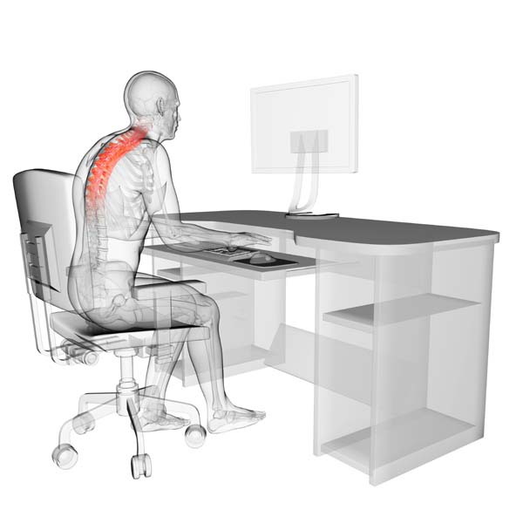
Occupational Sitting
Lindsay Harris
Ontario Lett
Sterling Smith
Zac Wheeler
Melissa Worley

Slide 3
“Today, our bodies are breaking down from obesity, high blood pressure, diabetes, cancer, depression and the cascade of health ills and everyday malaise that come from what scientists have named sitting disease.”
James Levine, MD, PhD
“Today, our bodies are breaking down from obesity, high blood pressure, diabetes, cancer, depression and the cascade of health ills and everyday malaise that come from what scientists have named sitting disease.”
~ James Levine, MD, PhD

Slide 4
List of Top Employee Medical Claims:
Musculoskeletal
Back Pain
Hypertension
Dislipidemia
Cancer
Behavioral Health
Depression
Obesity
Diabetes

Slide 5
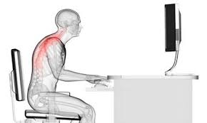
Priority Population
Approximately 100 employees at the Highmark corporate office in Pittsburgh, PA
Men and women
25 – 55 years of age
Sedentary occupational positions

Slide 6
Motivation to Change
Excessive sitting is a key risk factor in 4 of the top 7 killers in the United States: heart disease, stroke, diabetes, some cancers. It is also linked to obesity and early mortality rates.
“For people who sit most of the day, their risk of heart attack is about the same as smoking.”
Martha Grogan, MD, cardiologist, Mayo Clinic

Slide 7
Sitting Intervention
Exercise at desk
Health Risks Associated
Prolonged VS Interrupted
Workplace redesign
Social Support

Slide 8
Assessment
There are currently no public health guidelines about the exact amount of time adults should spend sitting at work.
Sitting Time Calculator
Occupational Sitting and Physical Activity Questionnaire

Slide 9
Health Risks Associated
Obesity
Body mass index
Waist circumference
Waist-to-hip ratio
Diabetes mellitus
Cardiovascular disease
Hypertension
Dyslipidemia
Musculoskeletal Complications
Certain cancers
Premature mortality

Slide 10
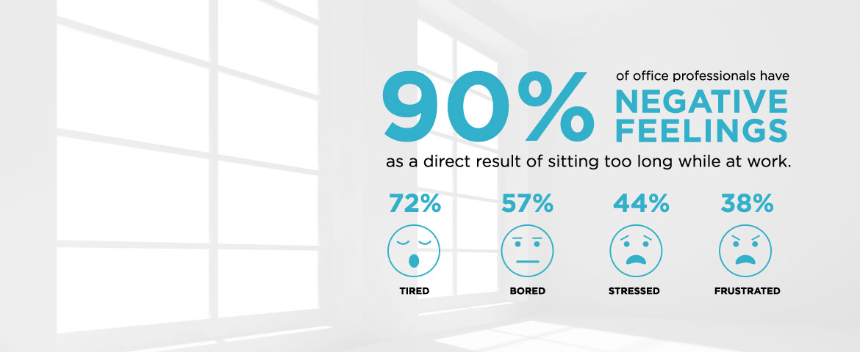

Slide 11
Prolonged VS Interrupted
Prolonged sitting is a risk factor for all-cause mortality, independent of physical activity.

Slide 12
S.M.A.R.T. Goal Setting
Specific
Take the stairs. Start with 3 flights day.
Measurable
Monitor daily step count with a pedometer.
Attainable
Postural control and proper body alignment
Realistic
Time-bound
Monitor sitting time outside of the office.
5 week program translating into long-term daily habits.

Slide 13
Social Support
Forms of Social Support
Health coaches
Partner groups
Peer groups
Building Social Support
Communication skills
Team objectives and goals
Effectiveness
Improvement rates
Improvement skills

Slide 14
Process Evaluation
Indicators
Assessment Tools
Effective testing
Group challenges
Individual point system accumulation
Retention rates
Check in with wellness team
Challenges and goals

Slide 15
Impact Evaluation
Indicators
Assessment Tools
Increase awareness of health risks associated with prolonged sitting
Surveys and questionnaires to determine awareness, knowledge, behavior changes, and attitudes
Increase knowledge prolonged vs. interrupted sitting time
Measure immediate participation rates and percent of employees involved with the interdepartmental activity challenges
Provide opportunities for involvement and social support

Slide 16
Outcome Evaluation
Indicators
Assessment Tools
Improve posture to eliminate or decrease prevalence of health issues
Interview with participants of sedentary improvements
Apply interrupting sitting methods in daily routine
Pedometer activity tracker to record movement
Improvement overall employee health and wellness

Slide 17
Budget
Item | Item Cost | Quantity | Total Cost
Activity Journals | $2.00 | 100 | $200.00
FitBit | $100.00 | 100 | $10,000.00
Total Projected Cost: $10,200.00
Item | Item Cost | Quantity | Total Cost
Lumbar Support | $40.00 | 100 | $400.00
Pedometers | $2.00 - 30.00 | 100 | $200.00 -$3,000.00
Activity Journals | $2.00 | 100 | $200.00
Total Projected Cost: $800.00 - $3,600.00

Slide 18
Activities | July | Aug. | Sept. | Oct. | Nov. | Dec. | Jan. | Feb.
Surveys, Questionnaires & Participating Population
Educational Materials
Activity Examples
Establish Communication
Develop Point System
Individual Categories & Secure Supplies
Equipment Relocation Plan
Training Staff

Slide 19
Logic Model
 |  | Outcomes
Input | Activities | Short Term | Intermediate | Long Term | Goal
FitBit Pedometers Lumbar supports Activity Journals Relocating equipment Education materials and informational | Seminars on health risks association and awareness Forums on applying interrupted sitting methods in routine and setting goals Discuss options and opportunities for social support Application of information learned in sessions | Improve awareness of health risks associated with prolonged sitting time Increase knowledge of prolonged vs. interrupted sitting time Change disposition regarding health promotion programs and sedentary behaviors | Increase interrupted sedentary time in work setting Improve social support in occupational setting | Improve overall employee wellness and quality of life Increase use of exercise work facilities in leisure time Improve work productivity and promote a healthy work environment | Create awareness and implement an intervention to improve overall employee wellness

Slide 20
Stand up for your health!

